Slide 1
Initial Testing Results
Michael Bransky, Noah Keyes, Vergil Sorg

Slide 2
Design Requirements Summary
Customer Requirements:
Measure expanded extrusion diameters
Temperature control for extrusion
Actuate axial force
Pressurize extrusions during testing
Stay within budget of $10,000
Complex and robust design
Engineering Requirements:
Apply a maximum 150 lbs of axial force
Expand extrusions with diameters of 0.02-0.625 inches
Measure expanded diameters up to 2.5 inches
Control temperature up to 250^{O}F
Pressurize extrusions up to 300 psi
Output measurements in easy to read format

Slide 3
Top Level Testing Summary
Micrometer repeatability test - confirms the repeatability of measurements taken with the micrometer
Temperature output test- confirms the ability of the heating system to reliably heat extrusions to 250^{O}F
Full system validation - confirms that the system is fully functional with all subsystems acting in unison

Slide 4
Top Level Testing Summary
Tests | Design Requirements
Micrometer Repeatability | CR 1, CR 4, ER 2, ER 3, ER 6
Temperature Output | CR 2, ER 4
Full System Validation | CR 1, CR2, CR3, CR4, CR6, ERs 1-6

Slide 5
Detailed Testing Plan - Micrometer Repeatability
Does the micrometer consistently take accurate measurements at the desired location?
Use gage pins to determine variability of micrometer measurements
Measure a gage pin several times over
Repeat for multiple sizes of gage pins
Calculate averages and standard deviations for micrometer measurements
Run through the process of inflating and measuring several extrusions to determine if the micrometer is measuring the correct location
Inflate and measure several extrusions
Record how far the point of maximum expansion is from the measurement centerline for each extrusion
Determine the average distance between measurement point and point of maximum expansion, and adjust piston stroke length accordingly

Slide 6
Detailed Testing Plan - Temperature Output
Can the temperature system produce accurate and repeatable temperatures up to 250F?
Conduct multiple test runs at different flow and temperature settings to evaluate if the system is outputting the desired temperature and if the flow distribution around the extrusion is acceptable
Redundant temperature sensors will record temperature at various locations such as the interior diameter of an extrusion and at the outlet of the heater nozzle to understand how the heated air behaves and if the temperature seen at the controller can be relied upon.
Stress test system to ensure no parts fail
Can the system be operated at the maximum temperature for a sustained period of time?
Limitations include heater air line rated for 450F, fastener tension, and radiation from heater to surrounding components.

Slide 7
Detailed Testing Plan - System Validation
After Dry Runs on 4/3/2022 Team Realized that testing force output of motor would be worthless
Axial load system can easily stretch hardest materials fully
Team has instead decided to go forward with a full DOE to ensure that system is fully working
This will have the added benefit of seeing what factors have the largest effect on diameter expansion
Team will be doing a 2⁴ full factorial experiment
Variables will be Flow Speed, Temperature, “Soak Time”, Balloon Hardness
Each test will involve running the axial system the full length, as well as taking the maximum measurement of each balloon before popping

Slide 8
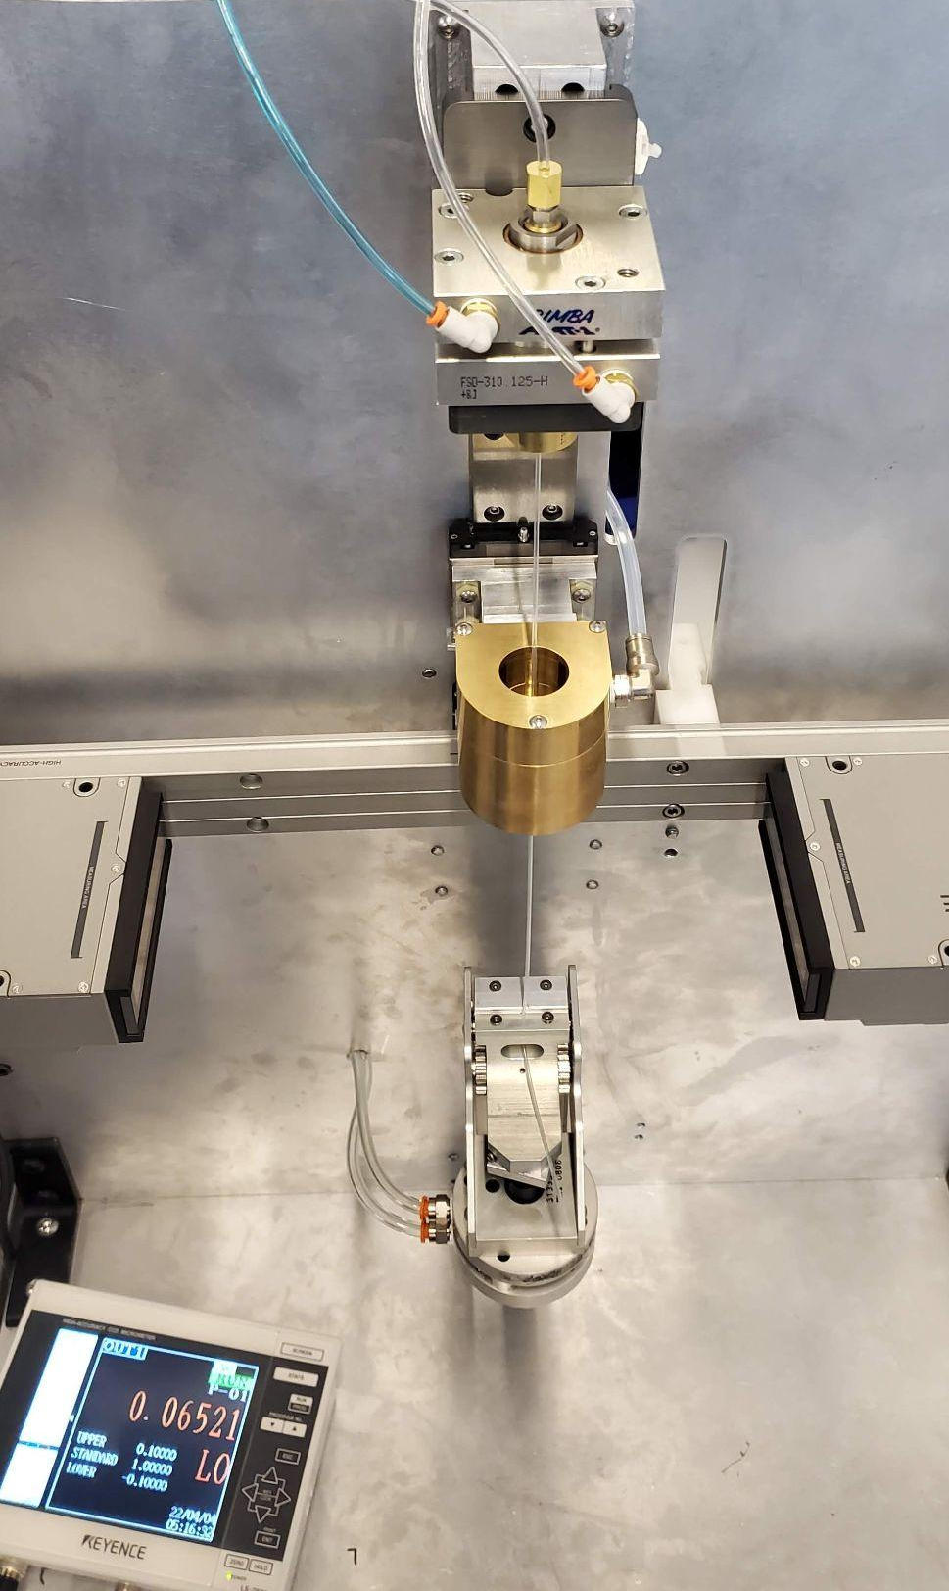
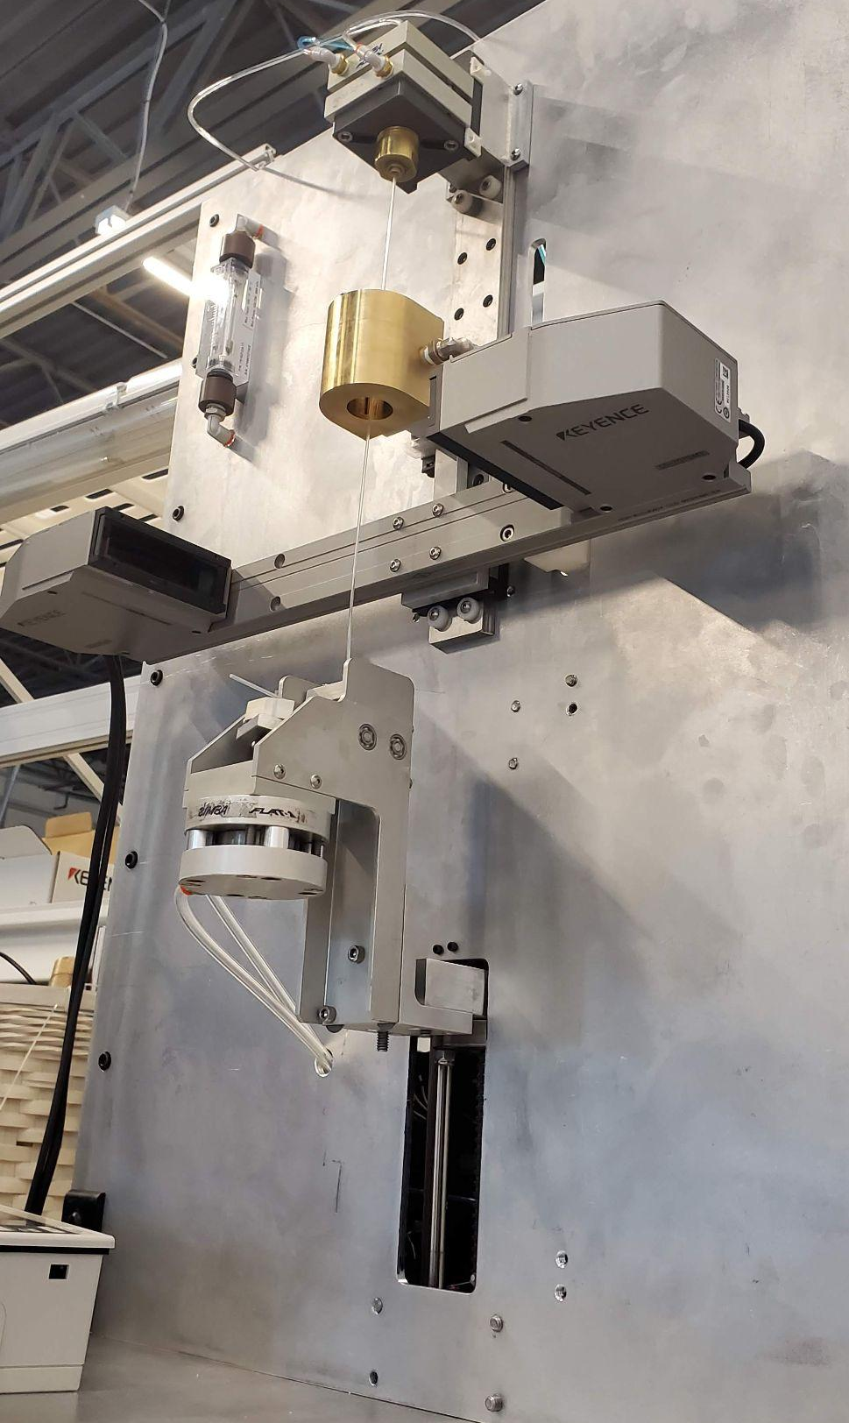
Testing Setup
Pressurizing with air from 150 psi compressor
Notable amount of water in lines
Using “Reject” tubing stock because it’s available

Slide 9
Testing Results
Trial “A” Nylon Tubing: 0.065” dia
“Dry Run” with ambient temperature: 0.0698 to 0.0398 = 0.030” necking
Temperature (C) | Pressure (psi) | Flow (CFM) | Soak Time (min) | Starting Dia (in) | Ending Dia (in) | Result
200 | 100 | 0.25 | 5 | 0.0652 | 0.0410 | 0.0242 necking
230 | 100 | 0.15 | 5 | 0.0653 | 0.0397 | 0.0256 necking
230 | 100 | 0.10 | 10 | 0.0656 | 0.0398 | 0.0258 necking

Slide 10
Testing Results
Trial “B” Pebax Tubing: 0.075” dia
“Dry Run” with ambient temperature: 0.0752 to 0.0550 = 0.0202” necking
Temperature (C) | Pressure (psi) | Flow (CFM) | Soak Time (min) | Starting Dia (in) | Ending Dia (in) | Result
150 | 100 | 0.20 | 2.5 | 0.076 | - | Clamped-end severed
200 | 100 | 0.20 | 5 | 0.0767 | - | POP (full travel dist.
200 | 100 | 0.20 | 10 | 0.0751 | - | POP (Half travel dist.

Slide 11
Testing Results
Trial “C” Pebax Tubing: 0.136” dia
No dry run
Temperature (C) | Pressure (psi) | Flow (CFM) | Soak Time (min) | Starting Dia (in) | Ending Dia (in) | Result
150 | 100 | 0.20 | 3 | 0.1363 | 0.1213 | 0.015” necking
200 | 100 | 0.20 | 8 | 0.135 | - | POP (full travel dist.

Slide 12
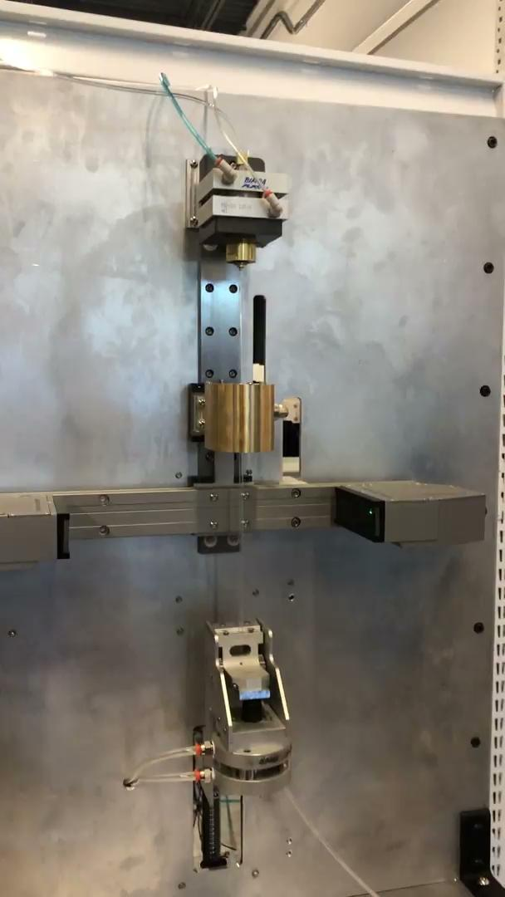
Trial “C” Pebax 0.136”: Drawing out extrusion

Slide 13
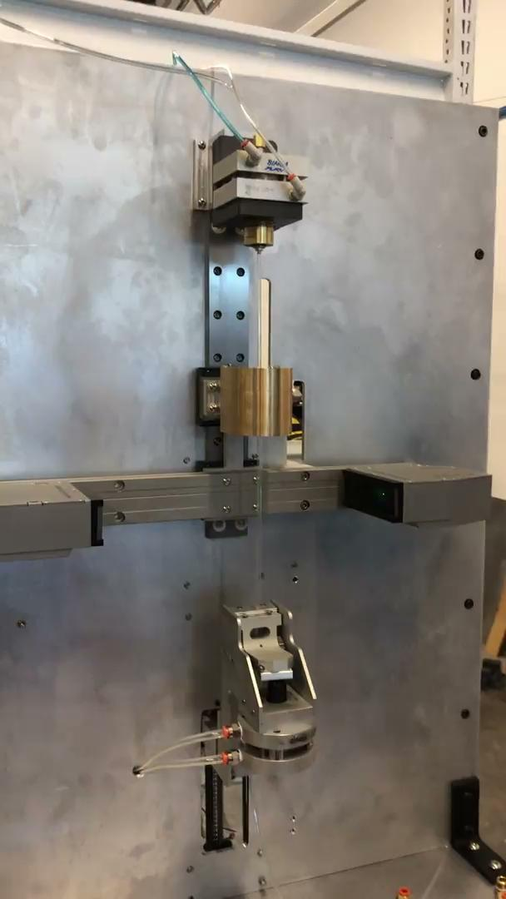
Trial “C” Pebax 0.136”: POP

Slide 14
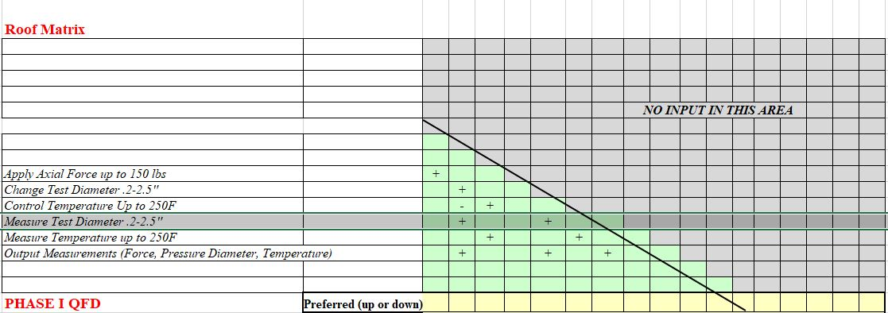
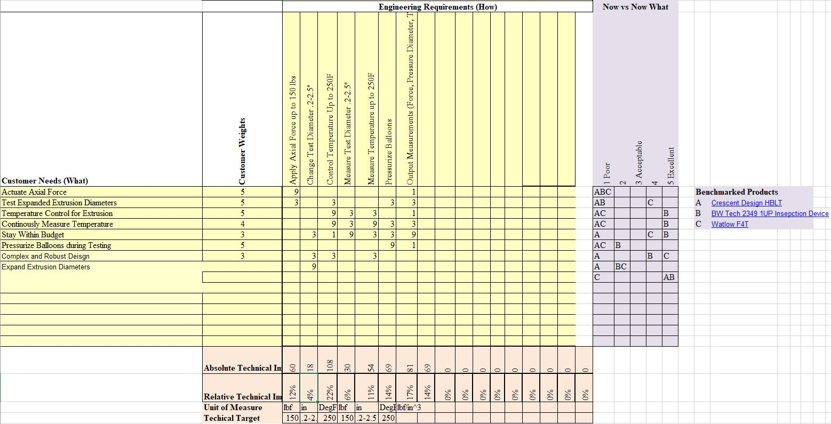
QFD

